Slide 1
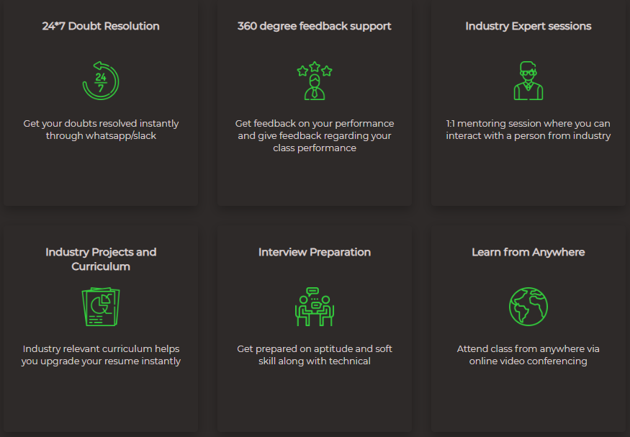
- Data Structures
Welcome to
CIPHER
SCHOOLS

Slide 2
Agenda
Gup-Shup
Overview of the course.
Software we’ll be using.
What all is required for the interviews?
How much time do I need to devote to this?
Know your worth!
The Mantra
Our Best Friends?
Lecture - 1

Slide 3
The Question
Why am I doing this? Is it Worth?

Slide 4
Let’s Introspect
Why Computer Science? – Is it all about money/ Mob Mentality?
Why Data Structures?
Is this difficult?

Slide 5
Data Structures & Algorithms
Prerequisites
Understand Java
Basic understanding of DS
At the end of the course, you should be able to –
Solve problems in given time and space complexity constraints.
Compete in any competitive programming competition.
Think in a proficient manner to find the best way to solve problems.
Demonstrate your understandings to anyone including the interviewers.

Slide 6
Data Structures & Algorithms
Overview of the Curriculum
Concepts of Java
Arrays & Recursion
Strings
Linked List
Stacks & Queues
Trees
Hashing
Heaps
Graphs
Dynamic Programming

Slide 7
Software
You will need JDK installed and,
You can use any IDE of your choice.
I’ll be demonstrating using Eclipse.

Slide 8
What all is required?
Refer the Doc:

Slide 9
Know your WORTH!!!

Slide 10
___________ is the Key!!

Slide 11
The Mantra!
What is the thing you can never buy?

Slide 12
The Mantra!
Respect it and utilize it wisely! Build yourself a Time Table

Slide 13

Our Friends!!
Errors / Bugs
PS: Only during the learning stages

Slide 14

Introduction to OOPs
Procedural Programming, vs
Object Oriented Programming

Slide 15
Procedural Programming (POP)
Object Oriented Programming (OOPs)
Derived from Structural Programming

Slide 16
Procedural Programming (POP)
Object Oriented Programming (OOPs)
Derived from Structural Programming
A program is divided into small parts called functions.
Procedural programming follows top down approach

Slide 17
Procedural Programming (POP)
Object Oriented Programming (OOPs)
Derived from Structural Programming
A program is divided into small parts called functions.
Procedural programming follows top down approach
Function is more important than data
Based on unreal world.

Slide 18
Procedural Programming (POP)
Object Oriented Programming (OOPs)
Derived from Structural Programming
A program is divided into small parts called functions.
Procedural programming follows top down approach
Function is more important than data
Based on unreal world.
No proper way for hiding data, so it is less secure.
Adding new data and function is not easy
Examples: C, FORTRAN, Pascal, Basic etc

Slide 19
Procedural Programming (POP)
Object Oriented Programming (OOPs)
Derived from Structural Programming
A program is divided into small parts called functions.
Procedural programming follows top down approach
Function is more important than data
Based on unreal world.
No proper way for hiding data, so it is less secure.
Adding new data and function is not easy
Examples: C, FORTRAN, Pascal, Basic etc
OOPs is based on real world.

Slide 20
Procedural Programming (POP)
Object Oriented Programming (OOPs)
Derived from Structural Programming
A program is divided into small parts called functions.
Procedural programming follows top down approach
Function is more important than data
Based on unreal world.
No proper way for hiding data, so it is less secure.
Adding new data and function is not easy
Examples: C, FORTRAN, Pascal, Basic etc
OOPs is based on real world.
Program is divided into small parts called objects.
Object oriented programming follows bottom up approach.
Data is given more importance than functions.

Slide 21
Procedural Programming (POP)
Object Oriented Programming (OOPs)
Derived from Structural Programming
A program is divided into small parts called functions.
Procedural programming follows top down approach
Function is more important than data
Based on unreal world.
No proper way for hiding data, so it is less secure.
Adding new data and function is not easy
Examples: C, FORTRAN, Pascal, Basic etc
OOPs is based on real world.
Program is divided into small parts called objects.
Object oriented programming follows bottom up approach.
Data is given more importance than functions
Data hiding is possible and hence more secure.
Adding new data and function is much easier
Examples: C++, Java, Python, C# etc.

Slide 22

What are Objects?
Anything that has a state and behaviour is known as an object.

Slide 23
What are Objects?
Anything that has a state and behaviour is known as an object.
Objects can be:
Physical: Car, Laptop, Pen etc.
Logical: Intangible object, like in some banking system.
They store data in form of variables and operate on this data using methods/functions.
An object is a real-world entity.
An object is an instance of a class.

Slide 24
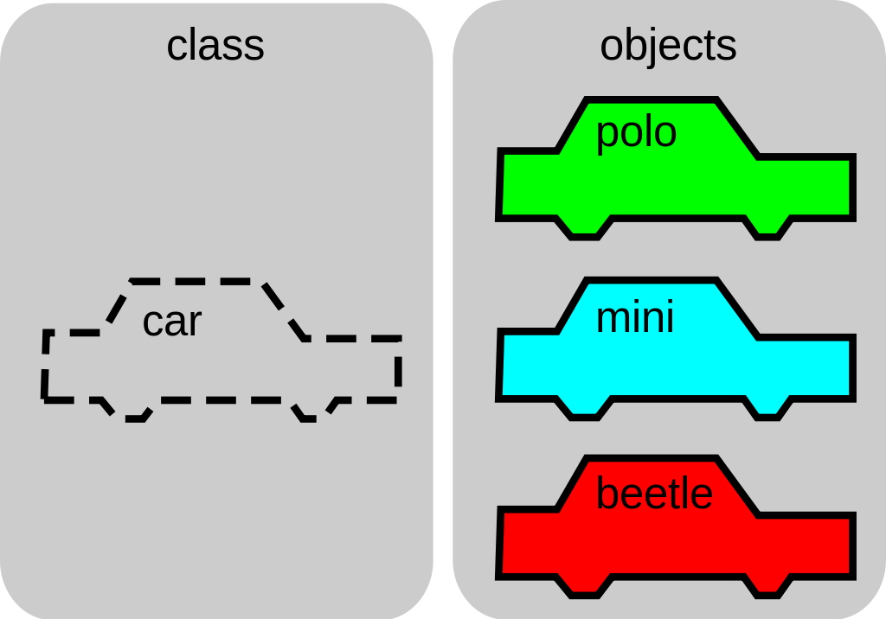
What are Classes?
A class is a group of objects which have common properties.

Slide 25
What are Classes?
A class is a group of objects which have common properties.
A class can be seen as a blueprint from which objects are created.

Slide 26
What are Classes?
A class is a group of objects which have common properties.
A class can be seen as a blueprint from which objects are created.
For example: A car can be a class and we can have various objects. Each car object has attributes(properties), such as weight and color, and methods (behavior), such as accelerate and brake.

Slide 27
Classes
Classes can contain:
Fields
Methods
Constructors
Nested class and interface
Creation of Objects of a class (Instantiation of a class):
Known as instantiation of a class
Objects share the attributes and the behavior of the class
Values of those attributes may be unique for each object
A class may have any number of instances

Slide 28
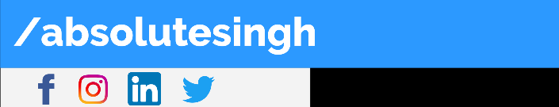
Thank You

